Slide 1

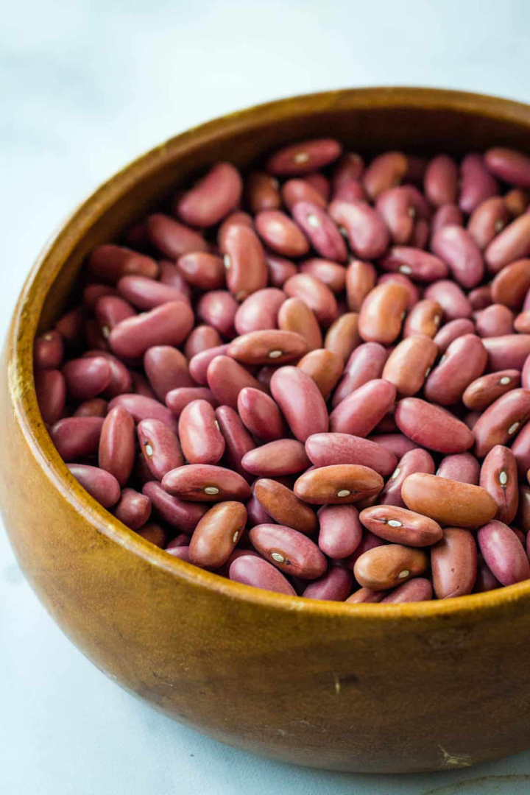

Dry Beans Classifications: A Machine Learning Project
Welcome to the world of machine learning and the fascinating project of Dry Beans Classifications! Join us on this journey as we explore the power of logistic regression algorithm.
SP
by Suman Patra

Slide 2

Preliminary Knowledge: Machine Learning Basics
1
An Introduction
2
Main Types of Machine Learning
3
Data and Features
Discover the fundamental concepts and principles of machine learning to understand the magic behind Dry Beans Classifications.
Dive into the importance of high-quality data and how to select and engineer meaningful features for effective classification.
Explore the differences between supervised, unsupervised, and reinforcement learning algorithms - and why we chose logistic regression.

Slide 3

Unveiling the Logistic Regression Algorithm
1
How Does It Work?
2
Model Training & Evaluation
Delve into the inner workings of logistic regression, its underlying assumptions, and why it is a perfect choice for our Dry Beans project.
Learn how to train the logistic regression model on our dataset and evaluate its performance using appropriate metrics.
3
Interpreting the Results
Uncover the secrets behind the logistic regression coefficients and how they reveal the relationship between features and classifications.

Slide 4
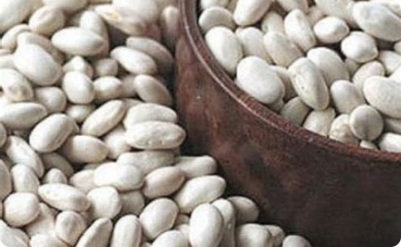
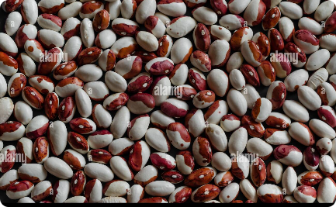

Unveiling the Dataset: Dry Beans Classifications
Source and Features
Exploratory Data Analysis
Data Visualization
Explore the origin of our extensive dataset and gain insights into the various attributes used for classifying dry beans.
Visualize the dataset using captivating graphs and charts to gain a better understanding of its characteristics.
Take a closer look at the distribution of the different classes and uncover any interesting patterns or anomalies.

Slide 5

Preparing the Dataset for Classification
1
Handling Missing Data
2
Data Cleaning and Normalization
3
Train-Test Split
Understand the importance of splitting the dataset into training and testing sets and the role it plays in evaluating model performance.
Discover the strategies employed to tackle missing values and preserve the integrity of the dataset.
Learn how we removed outliers, normalized the features, and ensured that our data is amenable to the logistic regression algorithm.

Slide 6
Implementation of the Logistic Regression Model
1
Model Architecture
Get an overview of the logistic regression model's architecture and understand how it makes predictions based on provided features.
Implementation Steps
2
Follow a step-by-step guide on how to implement the logistic regression algorithm using popular machine learning libraries.
3
Hyperparameter Tuning
Find out how we optimized the model's performance by tweaking hyperparameters and selecting the ideal combination for Dry Beans Classifications.

Slide 7
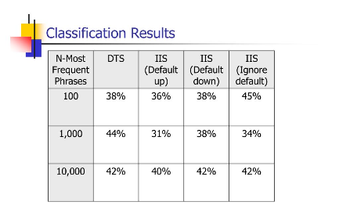
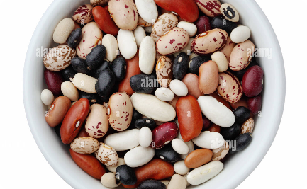
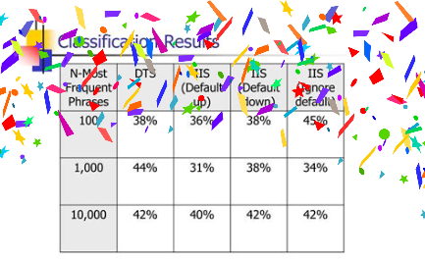
Results and Conclusion
Classification Performance
Practical Applications
Achievements and Future Directions
Discover the real-world applications and potential use cases of Dry Beans Classifications in improving agricultural practices.
Examine the accuracy, precision, and recall metrics to assess the efficacy of our trained logistic regression model.
Celebrate our accomplishments and explore future directions, including enhancing the model's accuracy and expanding the dataset.

